Slide 1


Education through collaborating on real world problems
https://omdena.com/chapters/

Slide 2

Solving community problems using Artificial Intelligence
https://omdena.com/omdena-chapter-page-nigeria/

Slide 3
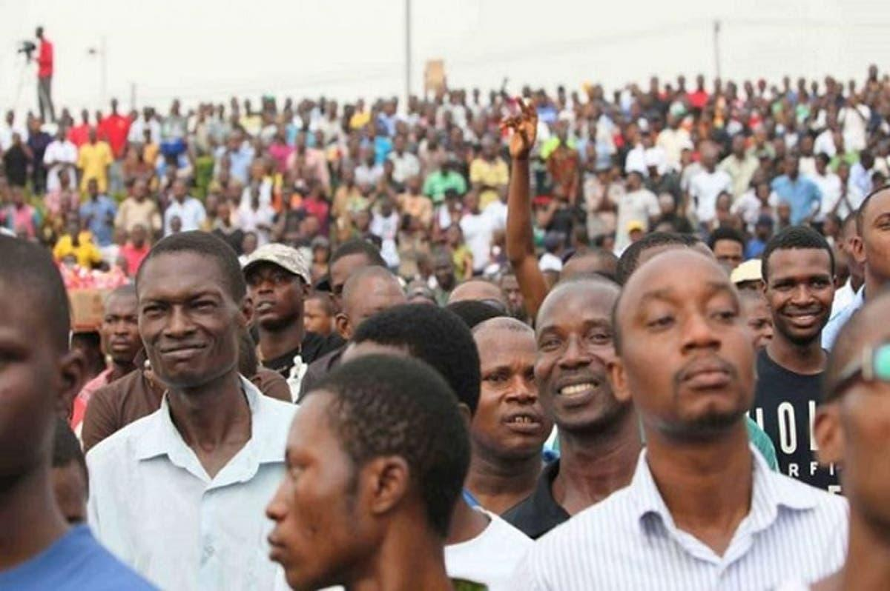
The Project
Solving Unemployment in Nigeria using Artificial Intelligence

Slide 4
Problem Statement
The Unemployment rate in Nigeria increased to 33.30 percent in the fourth quarter of 2020 from 27.10 percent in the second quarter of 2020 while the underemployed rate is 28.7% giving a total percentage rate of 61.9% of Nigerians that are unemployed or underemployed

Slide 5
Project Goals
To create a machine learning model that will merge NYSC graduates with possible job opportunities based on their career path
To provide employable job skills recommendation to NYSC graduates based on their their career path

Slide 6
Week 2: Task done
Data cleaning workshop training (recorded)
Data extraction workshop training
Introduction to EDA
Introduction to PowerBI
Data gathering & Data cleaning (in progress)
Workshop training tracking sheet: https://docs.google.com/spreadsheets/d/1XJOUdVbE3HBTTQSX8zxHpoaEwAh2_-L65kcsxk6Jpls/edit#gid=0

Slide 7
Week 3: Focus: Data Gathering
Article 1
https://towardsdatascience.com/building-a-job-recommender-for-non-technical-business-roles-via-nlp-and-machine-learning-626c4039931e

Slide 8

keep in touch on slack

